Slide 1

SQL Real Life Project Descriptive analytics of FIFA19 players

Slide 2
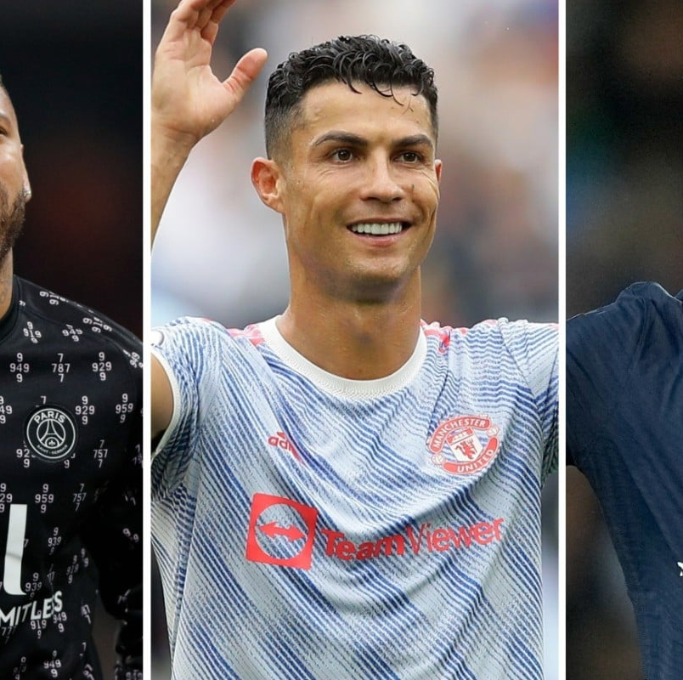
Learning Objective
Data Eyeballing
Data Dictionary
Questions we need answer of
Analyzing data and creating the table structure
Loading data to our MySQL table
Data Analysis – Simple Queries
Data Analysis –Advanced Queries

Slide 3

Data Eyeballing
Understand the data by open the file through excel
Get the basic idea about data

Slide 4

Data Dictionary
Data dictionary in very simple words , is the information which helps us understand the contents, structure and format of data.
It describes what each variable means in the dataset.

Slide 5
Data Dictionary for FIFA19
ID: Unique identification of the player
Name: Name of the player
Age: Age of the player
Nationality: Players Nationality
Overall: Overall Rating
Potential: Potential Rating
Club: Player belongs to this club
Value: Current Market Value in Euros
Wage: Current wage in Euros
Preferred Foot: Preferred Foot for playing
Jursey Number
Joined: Joining date
Height in feet and inches
Weight in pounds(lbs)
Penalties: Rating on a scale of 100

Slide 6
Questions we need answers of?
How many players are there in the dataset?
How many nationalities do these players belong to?
Which nationality has the highest number of players, what are the top 3 nationalities by # of players?
What is the total wage given to all players? What’s the average and standard deviation?
Which player has the highest wage? Who has the lowest ?
The player having the- best overall rating? Worst overall rating?
Club having the highest total of overall rating? Highest Average of overall rating?
What are the top 5 clubs based on the average rating of their players?

Slide 7

Questions we need answers of?
What is the distribution of players whose preferred foot is left vs right?
Which jersey number is the luckiest?
What is the frequency distribution of nationalities among players whose club name starts with M?
How many players have joined their respective clubs in the date range 20 May 2018 to 10 April 2019(both inclusive)?
How many players have joined their respective clubs date wise?
How many players have joined their respective clubs yearly?

Slide 8
Questions we need answers of?
What is the distribution of players whose preferred foot is left vs right?
How many players have joined their respective clubs in the date range 20 May 2018 to 10 April 2019(both inclusive)?
How many players have joined their respective clubs date wise?
Which jersey number is the luckiest?
What is the frequency distribution of nationalities among players whose club name starts with M?
How many players have joined their respective clubs yearly?

